Slide 1
CS5228 Project Progress Update (Team 46)
Ma Yuan, Huang Lifu, Joel Huang, Jefferson Sie

Slide 2
Data Preprocessing
Imputing NaN attributes or one incorrect attribute
Built year, number of beds, number of baths
Converting square meters to square feet for units with size < 200 square feet
Dropping outliers
2 or more unreasonable attributes
Classifying NaN floors of landed properties as “no_level”
Classifying NaN floors as its own category
Pairing ‘total_level’ and ‘floor_level’ into one combined attribute
Changing ‘na’ furnishing to ‘unspecified’
Extracted the different available bedroom types
Find missing subzone and planning_area of 4 missing condominiums online

Slide 3
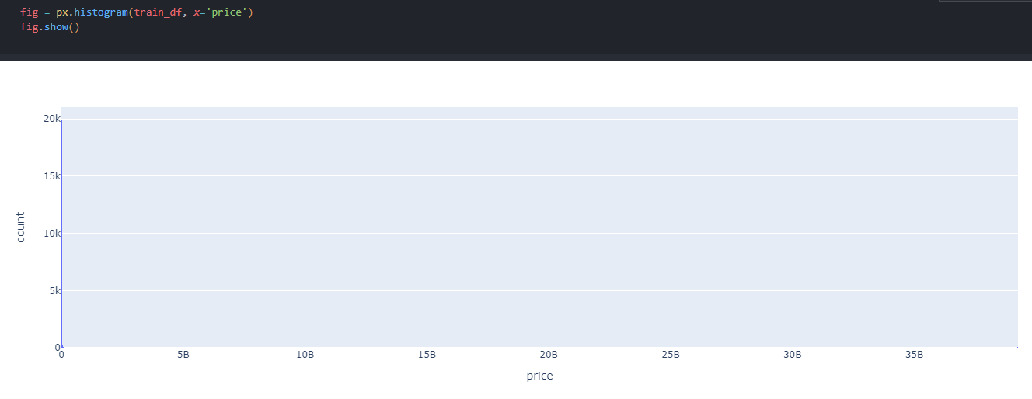
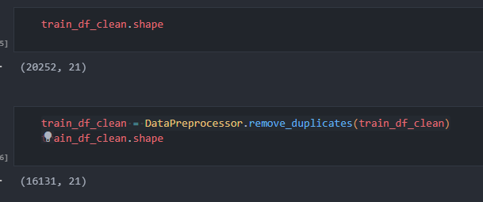
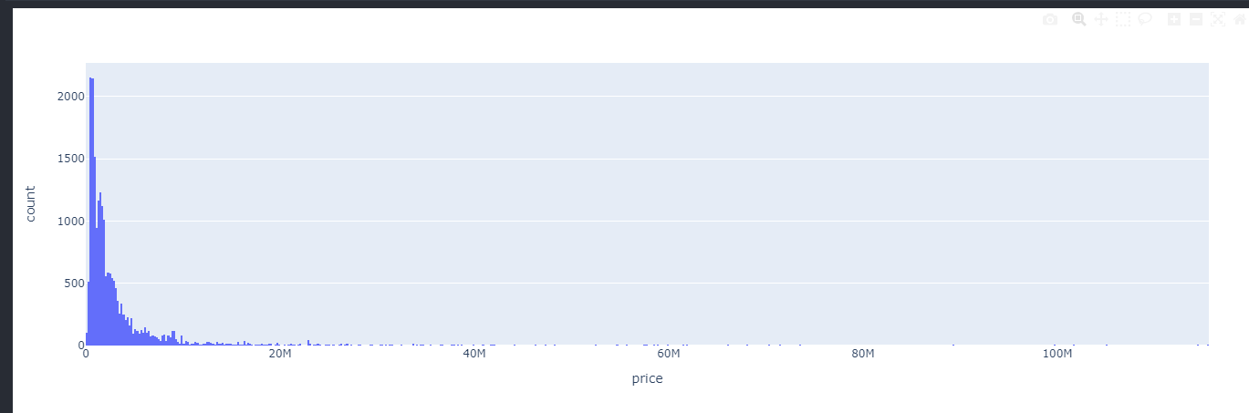
Pre-processing: Price Outliers & Duplicates Records
Price Outliers
Duplicates Records
Types of Duplicated Records
same attribute records same price
Prune duplicates
same attribute records but different price
take average of the price

Slide 4
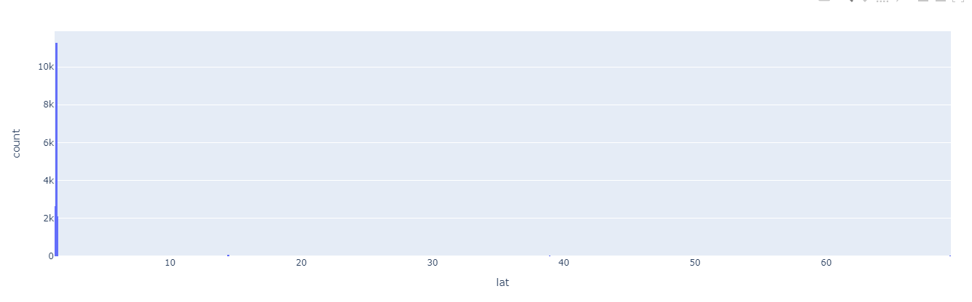
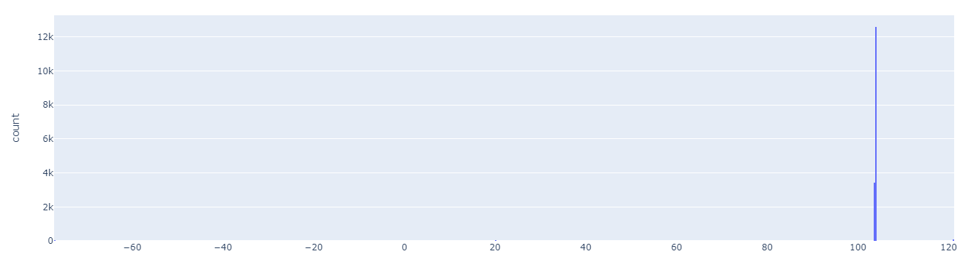
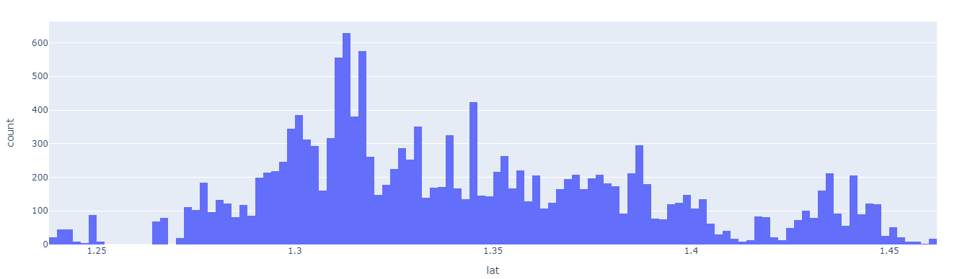
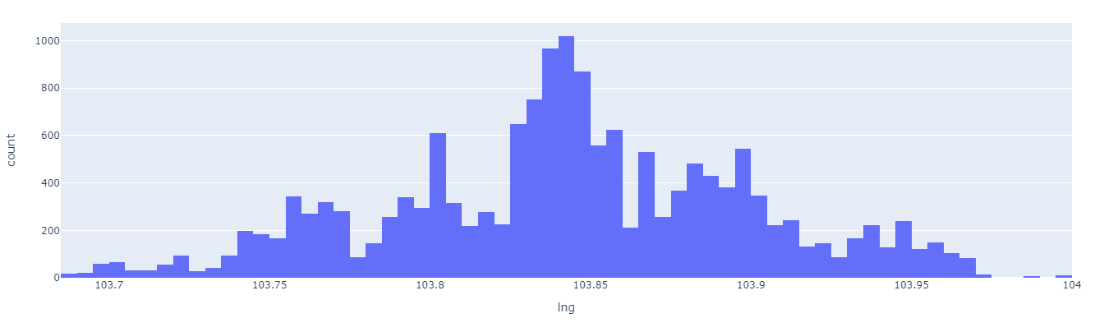
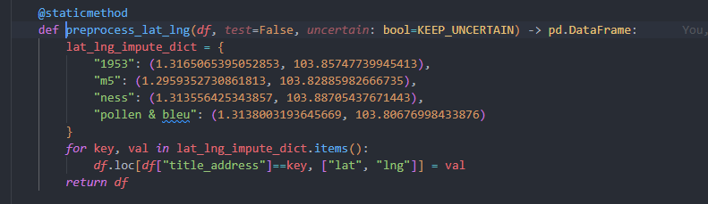
Pre-processing: Title, Address, Property name & (lat & lng)
Title
Location(lat & lng)
Containing following attributes (overlapped with other fields)
property_type
num_beds
location
Usage: Impute for other attributes
wrong records!
Address & Property name
Not useful itself as one attribute for model
Maybe useful for impute subzone/ planning_area
Drop the column

Slide 5
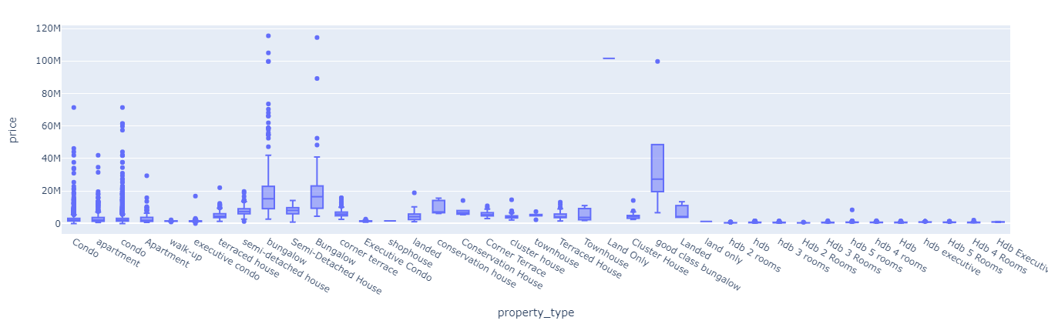
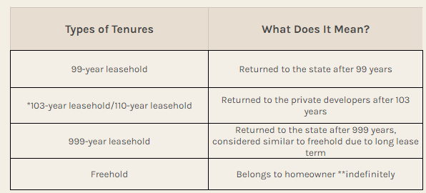
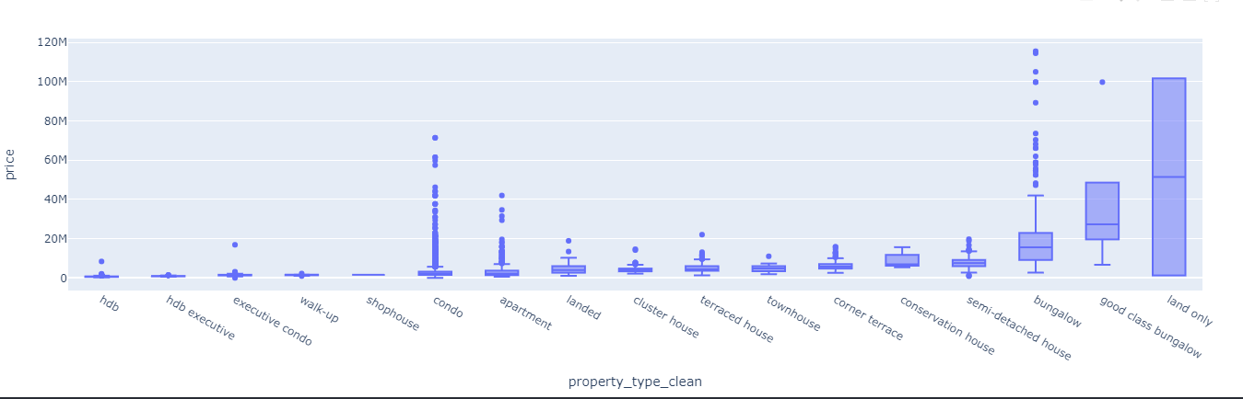
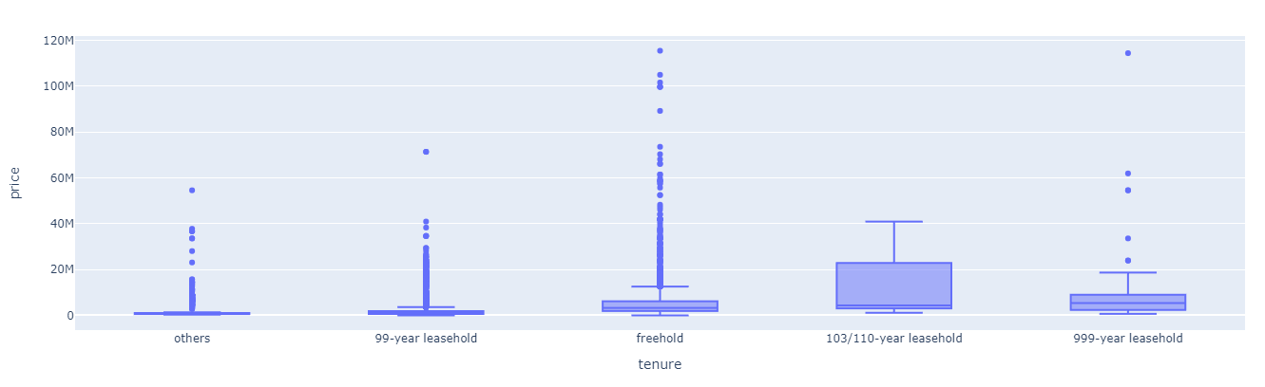
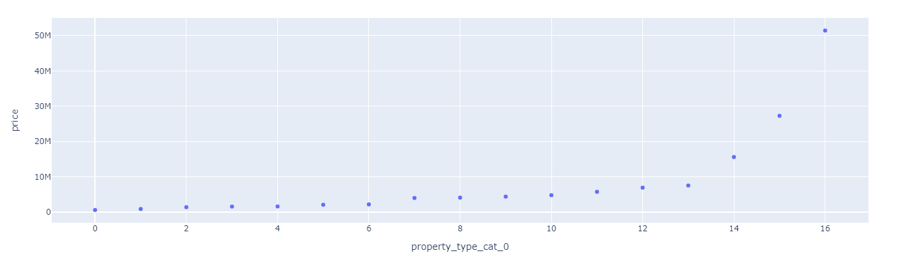
Pre-processing: property_type & tenure
property_type
tenure
ordinal category
small letter
hdb vs hdb {n} rooms vs Hdb Executive
missing 1595
One Hot encoding

Slide 6
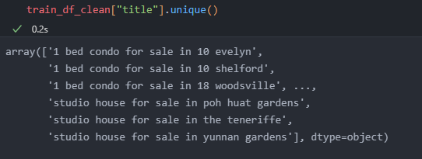
Pre-processing: built_year & num_beds
built_year
num_beds
missing 789
missing 70
Imputation process
Same location(lat & lng)
=> unique built year(built_year, NaN)
=> impute with the available unique built_year
Refined group
lat & lng & property_type_clean/block_number
Challenge: still has unresolved missing data
Solutions:
Keep as NaN: XGboost can handle missing data
Drop them
Imputation process
Impute missing ‘num_bed’ from ‘title’
Impute the rest missing data by grouping from ‘size_sqft’ and taking median of each subgroup

Slide 7
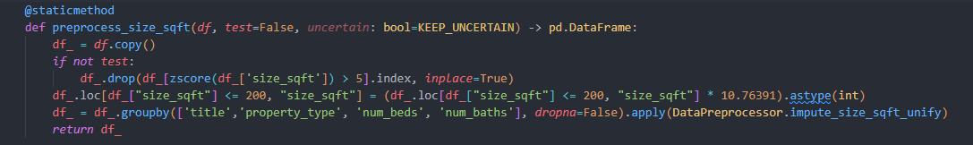
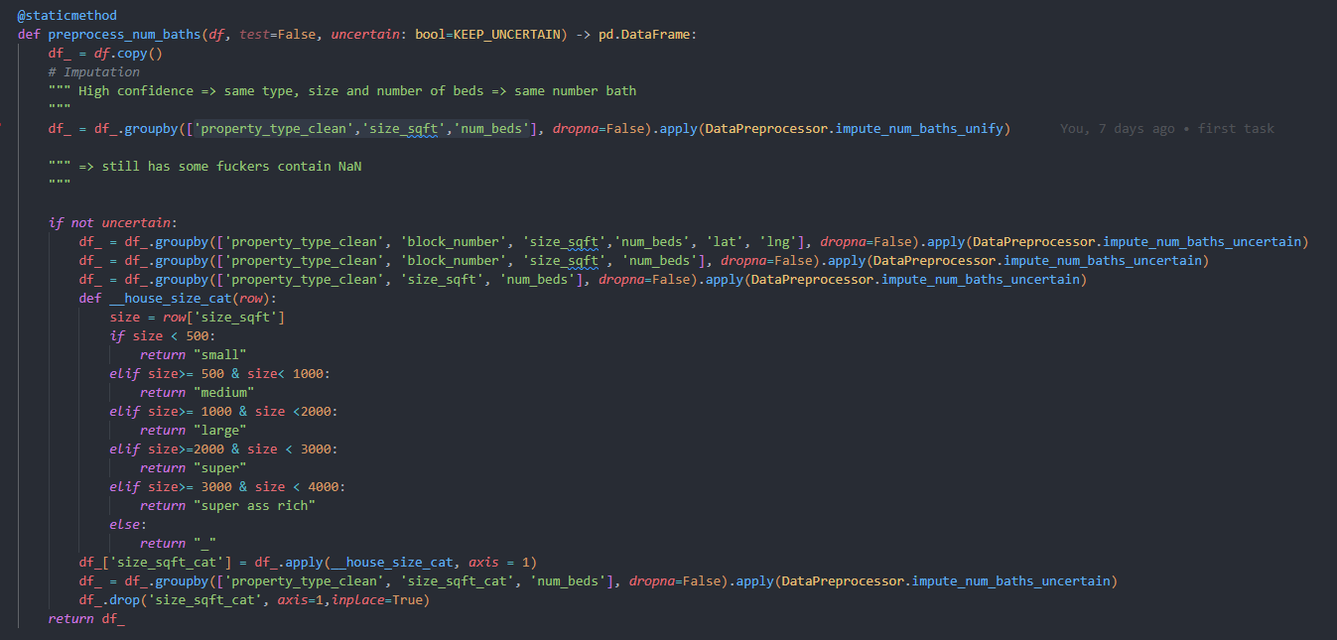
Pre-processing: num_baths & size_sqft
num_baths
size_sqft
missing 306
Wrong records!
Imputation process
Groupby
('property_type', 'block_number', 'size_sqft','num_beds' )
=> unique num_baths (num_baths, NaN)
=> impute with the available unique num_baths
Others (uncertain way to impute)
Refining the imputation groups
Based on the property size
Correct wrong units
From sqm => sqft
Missing value
Imputation process
Groupby
('title','property_type', 'num_beds', 'num_baths')
=> unique size_sqft (size_sqft, NaN)
=> impute with the available unique size_sqft

Slide 8
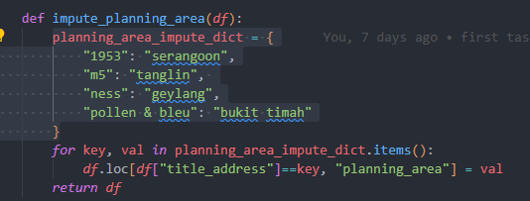
Pre-processing: floor level, furnishing & available unit types & planning_area
floor_level
available_unit_types
Features extraction
Floor_level: ['ground', 'low', 'mid', 'high', 'top', 'penthouse', 'no_level', 'nan'] (OneHotEncoder)
Total_level: #number of total floors or ‘nan’ (OrdinalEncoder)
Features extraction
Number_of_types_available
Has_studio
Min_br_available
Max_br_available
furnishing
available_unit_types
Unify ['unspecified', 'nan'] to 'unspecified'
Using OneHotEncoder

Slide 9
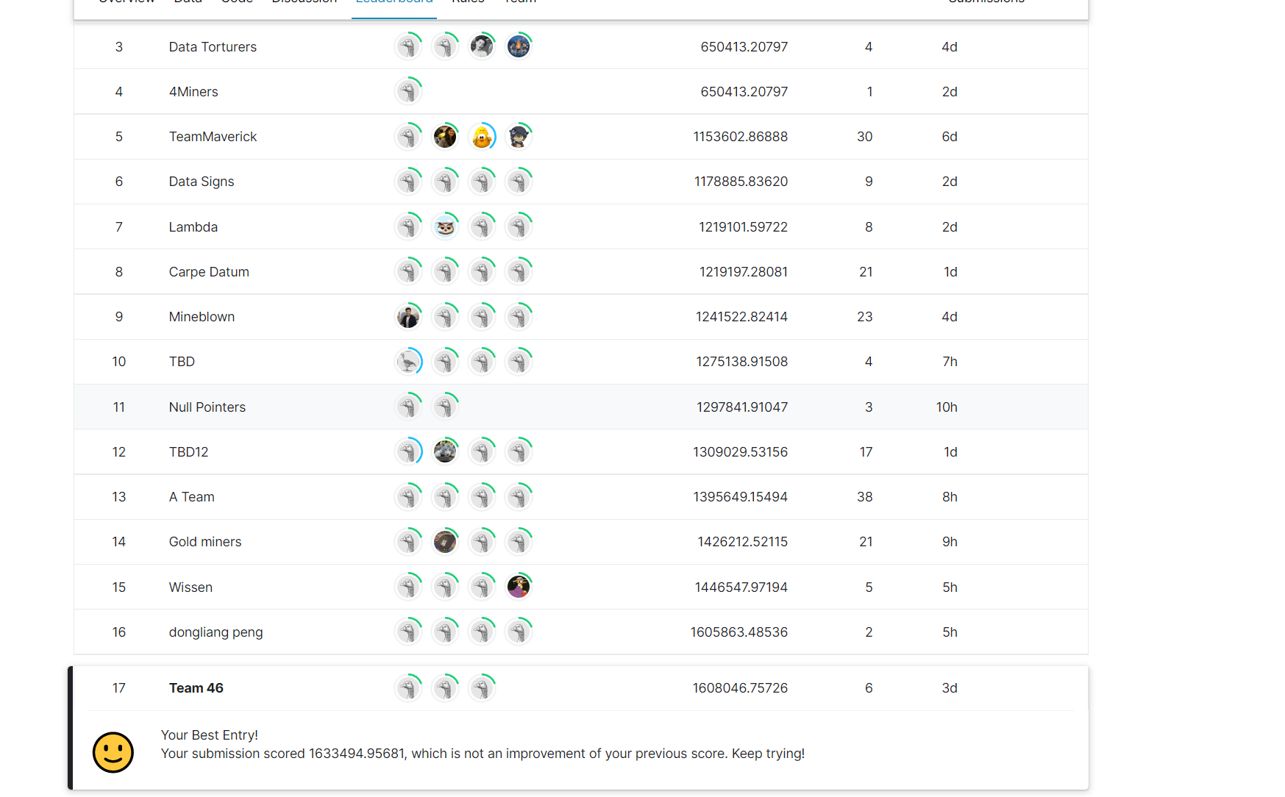
Building model: XGboost
XGboost : able to handle with missing data (treated as one branch)
Hyperopt: searching best hyperparamters
RepeatedKFold cross validation

Slide 10
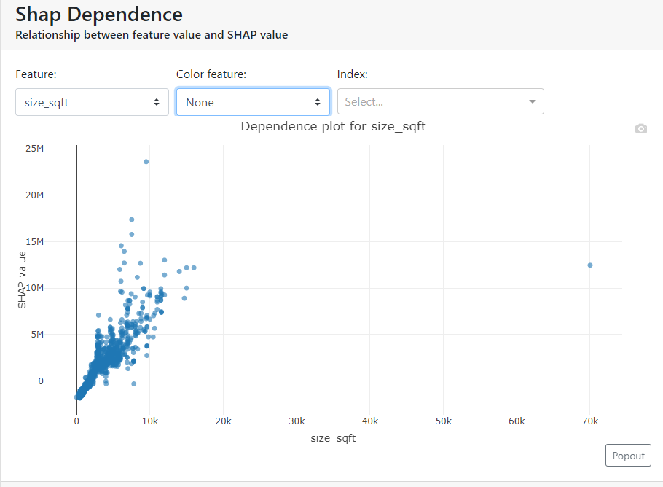
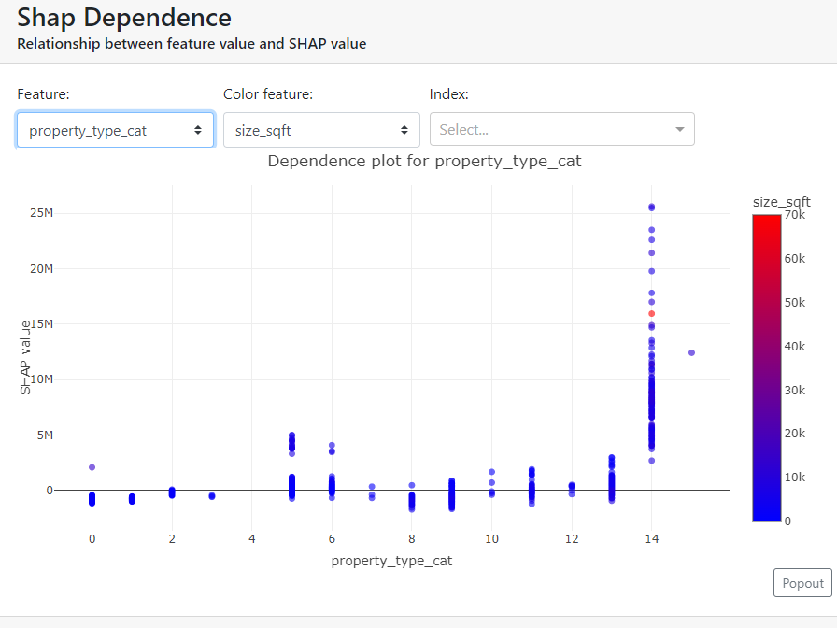
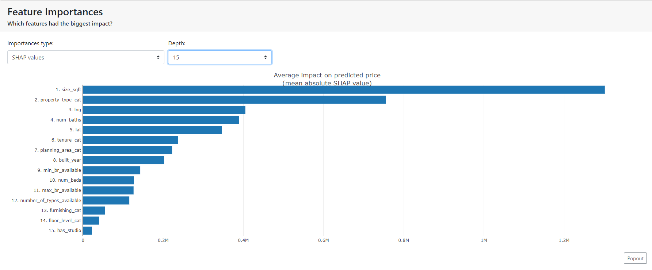
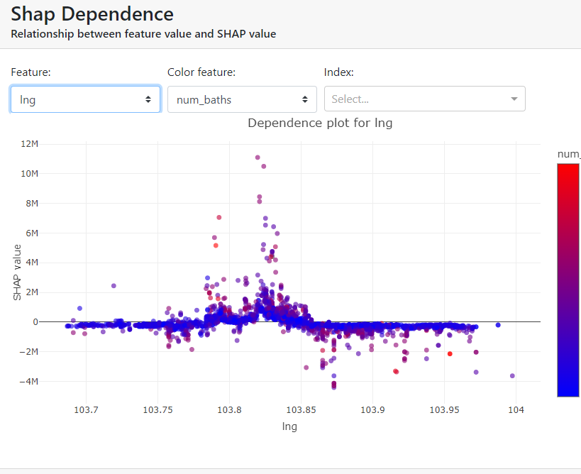
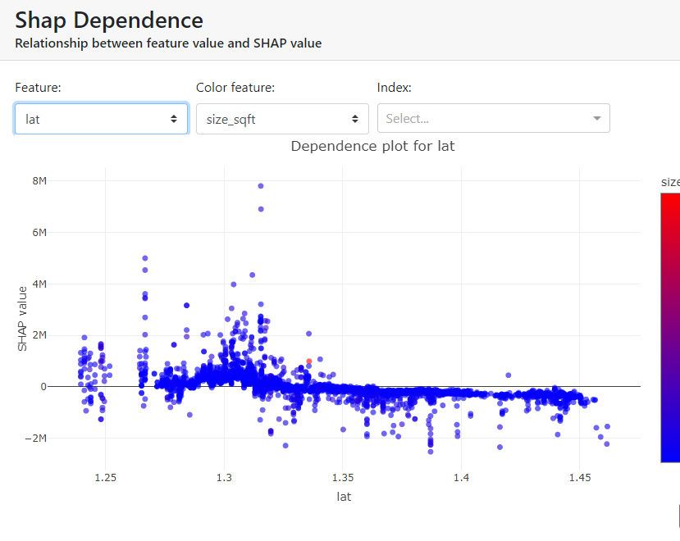
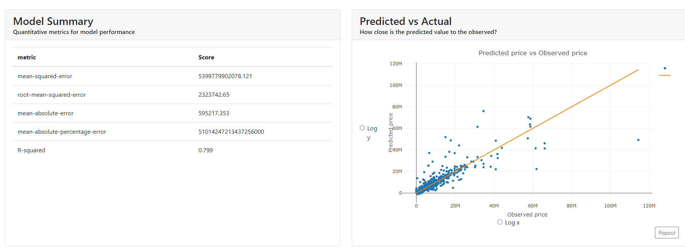
Model Interpretation

Slide 12
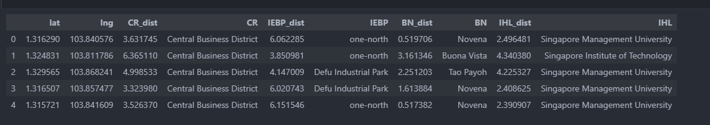
Task 1 (Price Prediction)
Unfinished Tasks
Better preprocessing strategies
Utilize the Auxiliary Dataset
What are the closest facilities?
What is the distance to its closest facility?
E.g. sg-commerical-centres.csv

Slide 13
Task 2 (Property Recommendation)
Objective: Given a user’s historical searches, recommend similar properties
Methodology:
Generate simulated user data based on various patterns
Patterns include:
Size of housing
Type of housing
Area (North, South, East, West, Central)
Proximity to MRT stations
Proximity to primary schools

Slide 14
Task 3 (Open Task) - Idea 1
Objective: Price distribution prediction based on subset of features
Motivation: Homeowners looking to sell their homes often engage property agents or HDB to do a valuation of their property. They may be clueless beforehand thus find assurance in knowing the price range in which their property lies.
Methodology:
Present a dashboard of price distribution based on features that homeowners input

Slide 15
Task 3 (Open Task) - Idea 2
Objective: Exploring out-of-distribution inputs
Motivation: Analyzing our model’s robustness to artificial (but plausible) changes in certain features
Methodology:
Analyze the outliers in the training data
Generate similar data points to the outliers and/or more extreme outliers
Measure the model’s robustness to these data samples
Problem: No labeled targets to quantitatively verify performance

